Slide 1
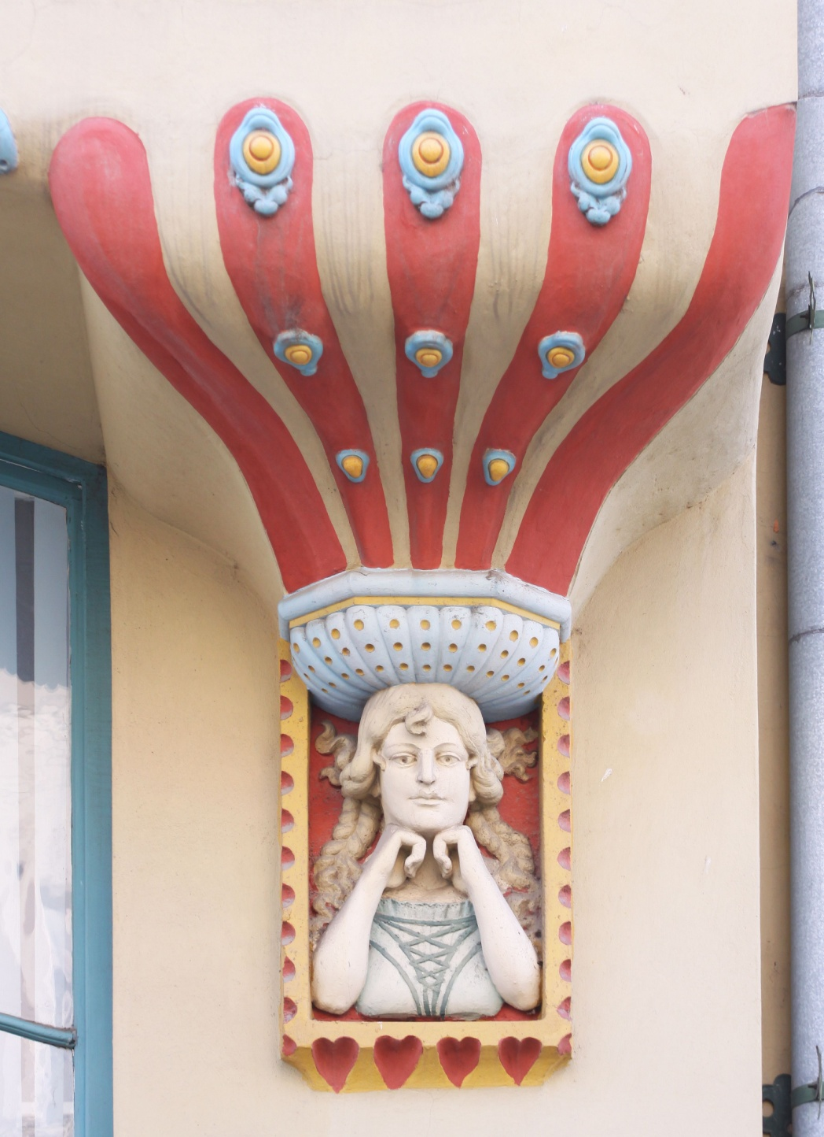
THIS IS US

Slide 2
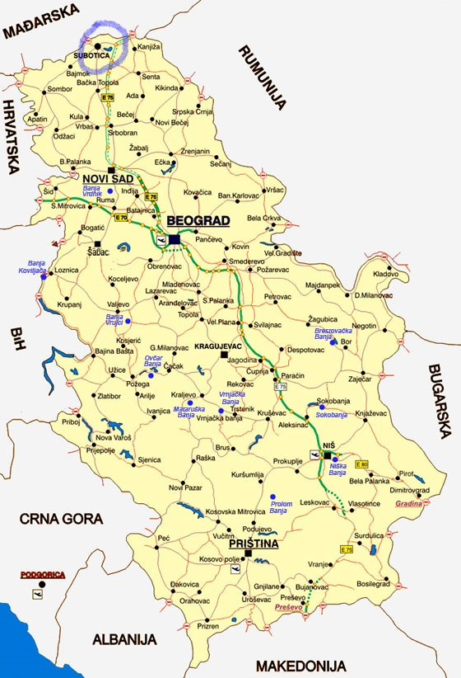

Slide 3
SUBOTICA – OUR HOMETOWN
Small town in the north of Serbia, near the Hungarian border.
Today more than 20 ethnic minorities live here. It is home to 150,000 citizens, whose uniqueness turned Subotica into a true museum of different cultures and religions.

Slide 4
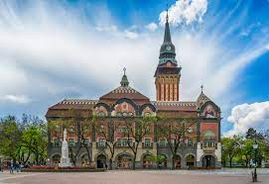
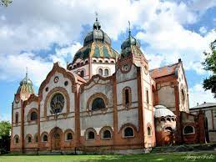
ARCHITECTURE OF SUBOTICA
TOWN HALL
SYNAGOGUE

Slide 5
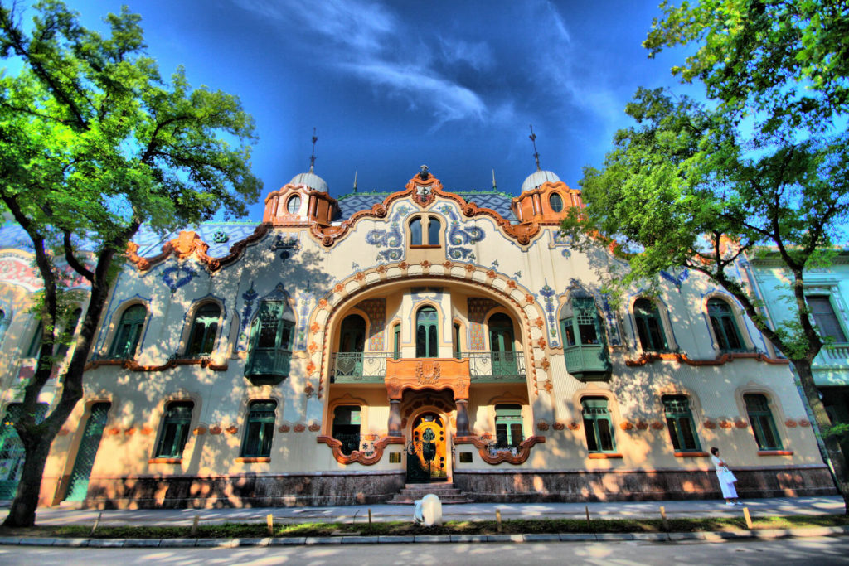
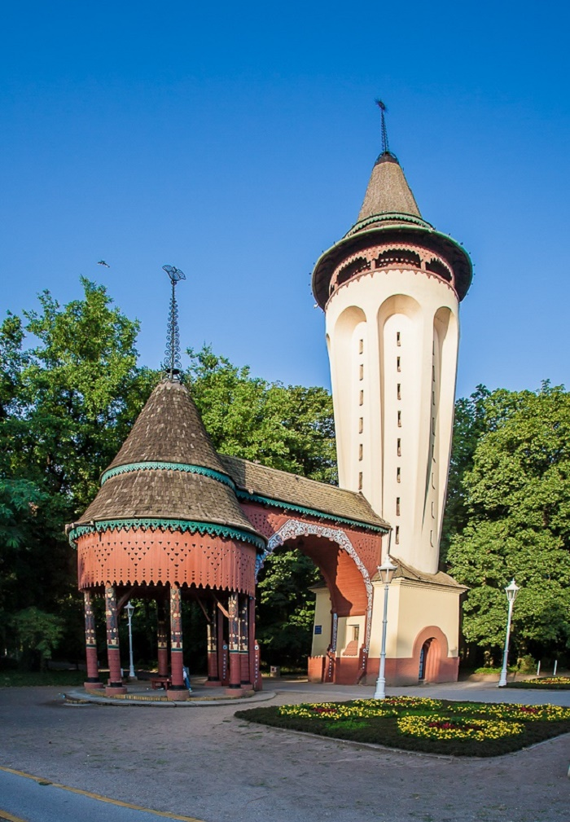
RAICHLE PALACE
WATER TOWER IN PALIĆ

Slide 6
Subotica is a host to many cultural activities …

Slide 7
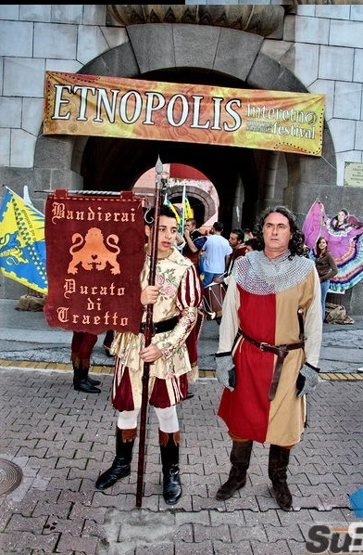
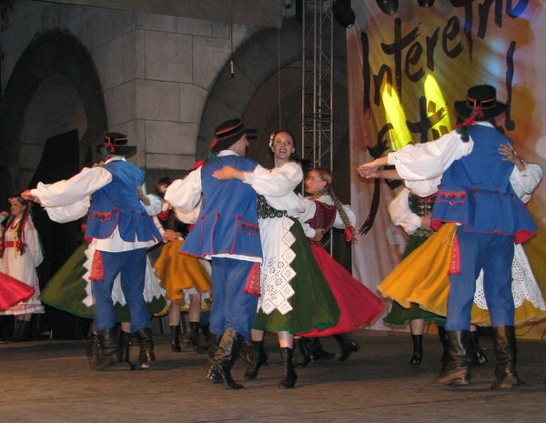

Slide 8
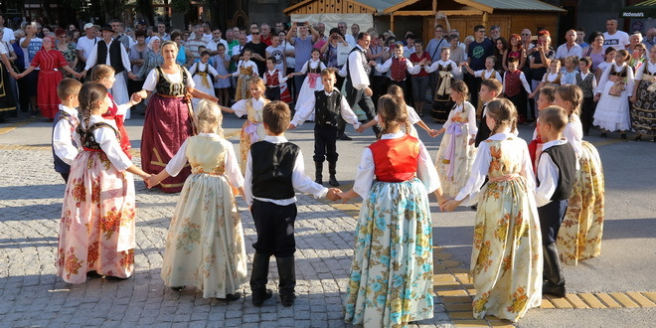
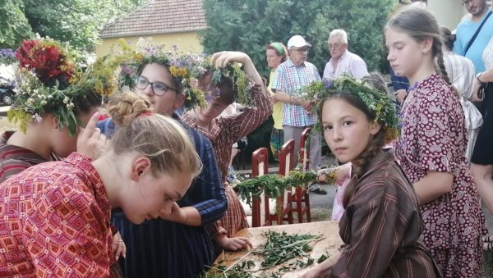
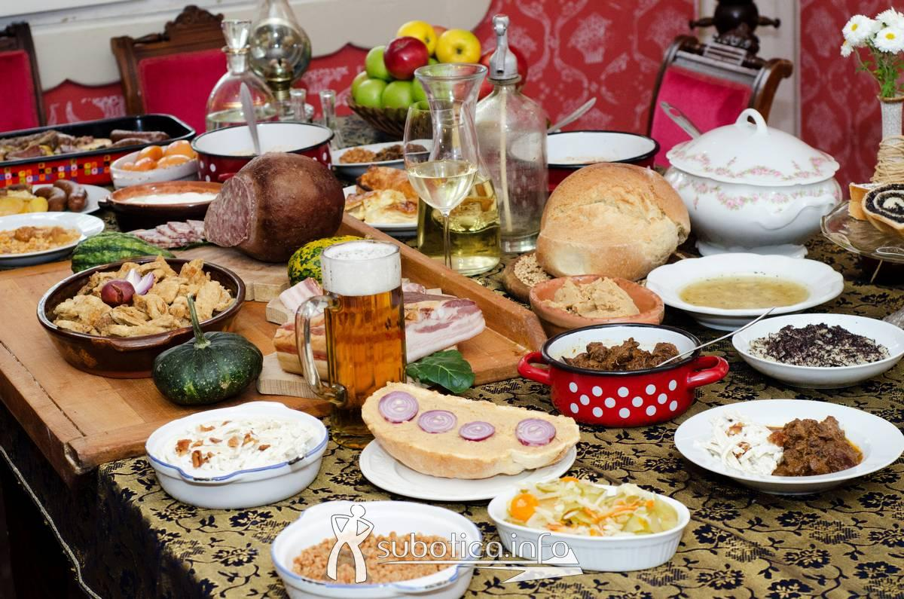
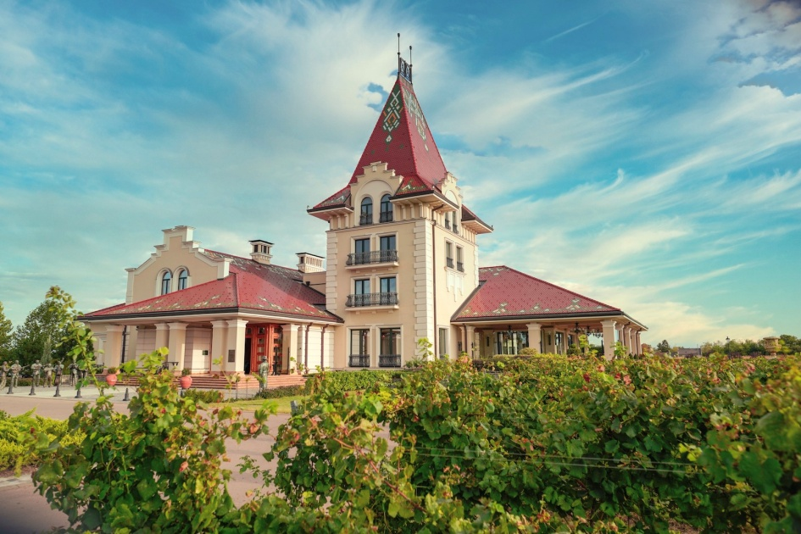
The soul of Subotica are its people - with their diversity, different customs, religions, languages, food, but the love for their hometown is what unites them.

Slide 9
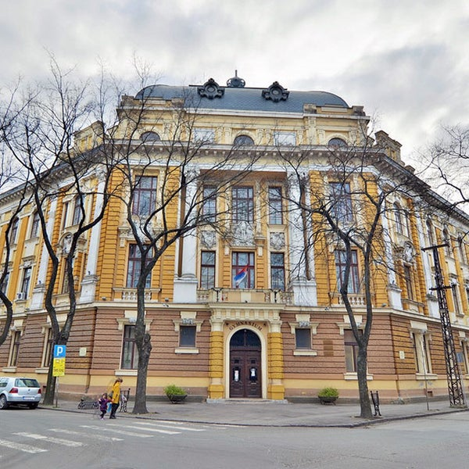
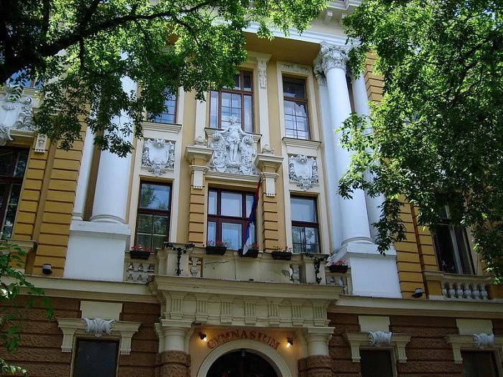
Gimnazija „Svetozar Marković”
Founded in 1795, built in 1895

Slide 10
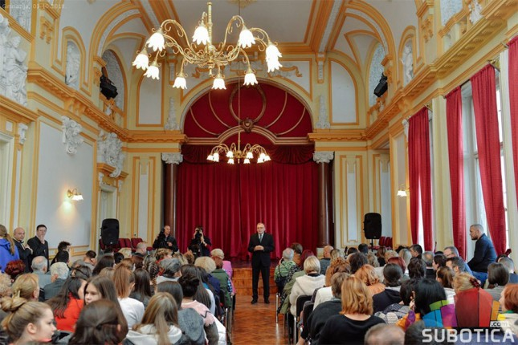
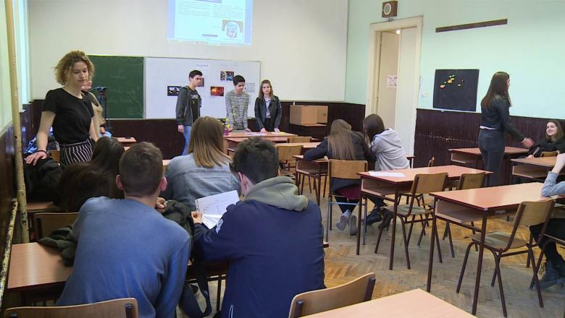
The building
2 floors, 17 classrooms, 9 specialized classrooms for sciences, art and computer rooms

Slide 11
About the school
Traditional branches:
Humanities and languages
Natural sciences
General
New branches:
Computer science
Sports
Three teaching languages: Serbian, Hungarian and Croatian

Slide 12
About the school
40 classes, 865 students and 92 teachers
Competitions, projects
Many programmes during the schoolyear: concerts, Day of Healthy Food, School’s Day, prom, the Patron Saint of Schools in Serbia
Notable alumni: writers, athletes, actors, scientists, etc.

Slide 13
